Slide 1
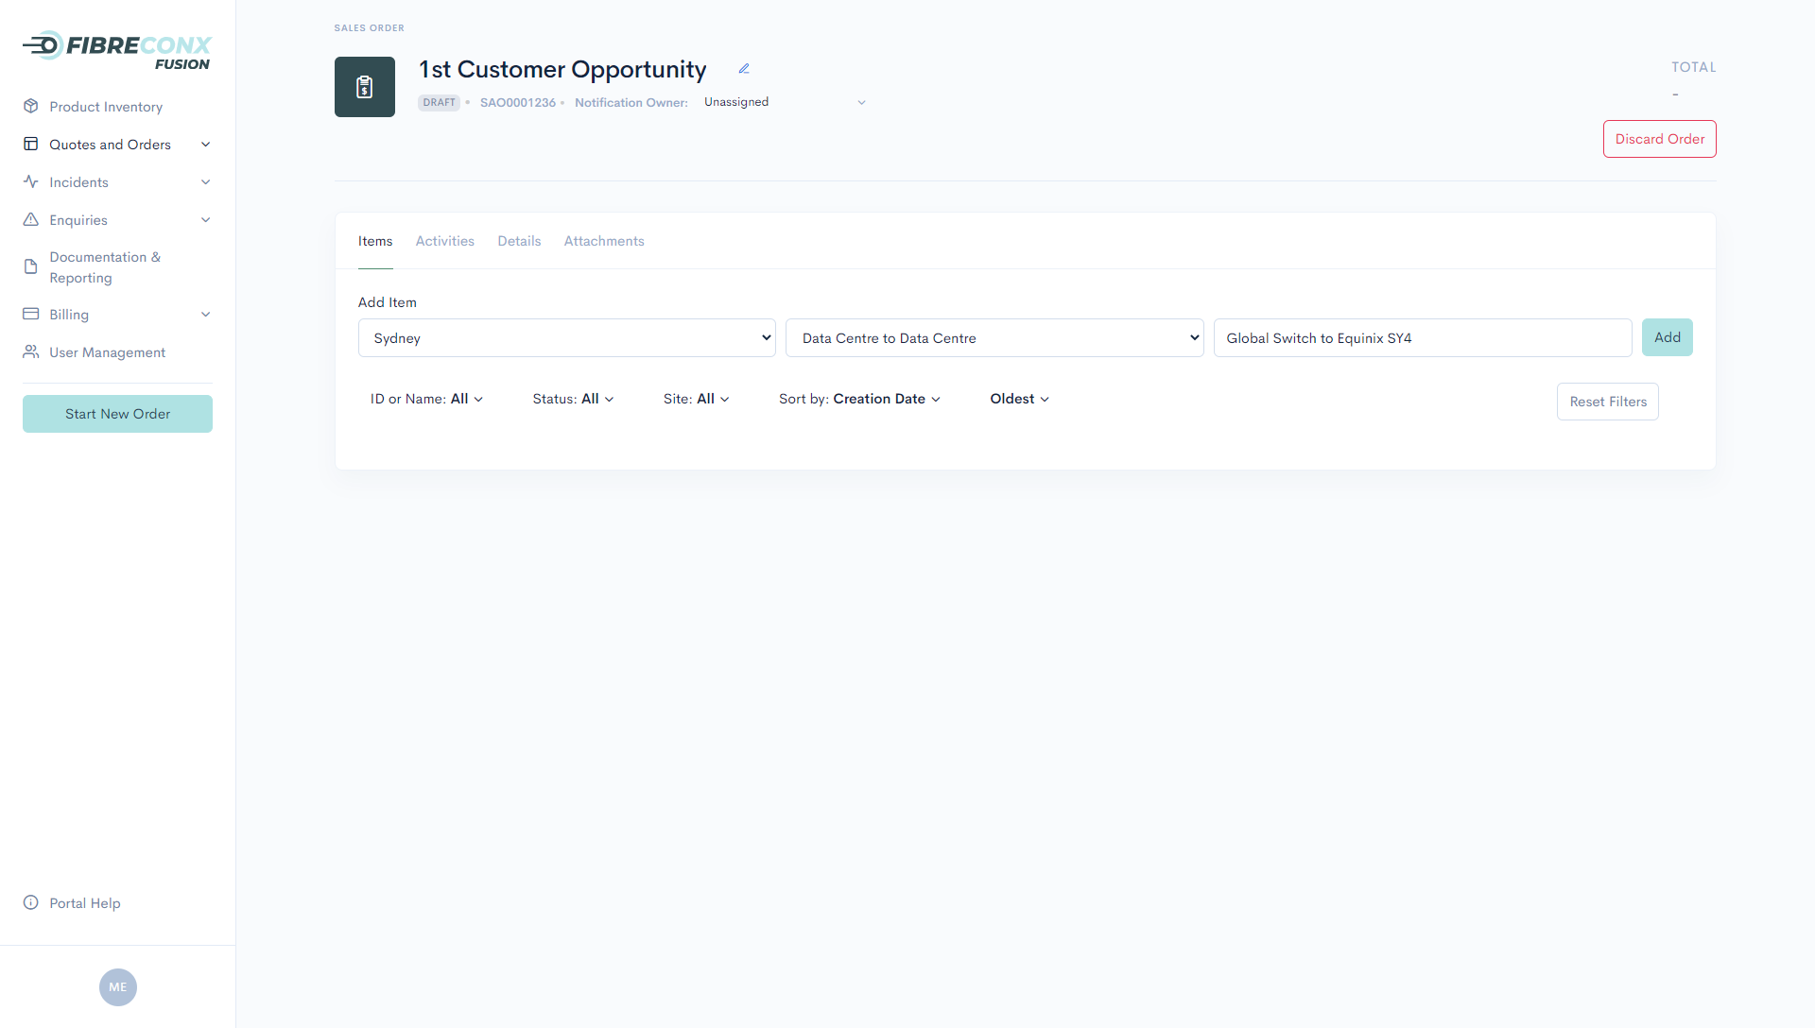
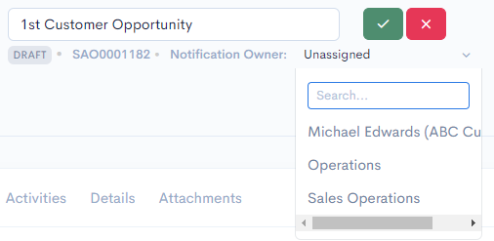
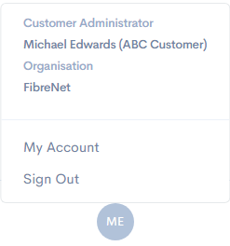
Qualification, Quoting & Ordering
Service Inventory
Raising Service Incidents & Enquiries
Invoicing & Payments
User Administration
1
2
3
4
3
Sales Order/Quote
Control the naming of the Sales Order (aka Quote, Opportunity), and the portal user or team who receive related communications
4
Adding Product Orders
Add one or more Product Order lines to the Sales Order, with each line item representing one or more dark fibre services connecting two locations via a single path
1
Navigation Menu
Use this screen to navigate to various functional areas of the portal
- Product Inventory
- Quotes & Orders
- Incidents
- Enquiries
- Invoicing & Payments
- User Management
User Account
Click here to view your user account details, including role & associated organisation.
‘My Account’ provides further details, including allowing you to manage your contact details, & see your Multi-Factor Authentication (MFA) status
Next >
2
Notes:
Landing Page

Slide 2
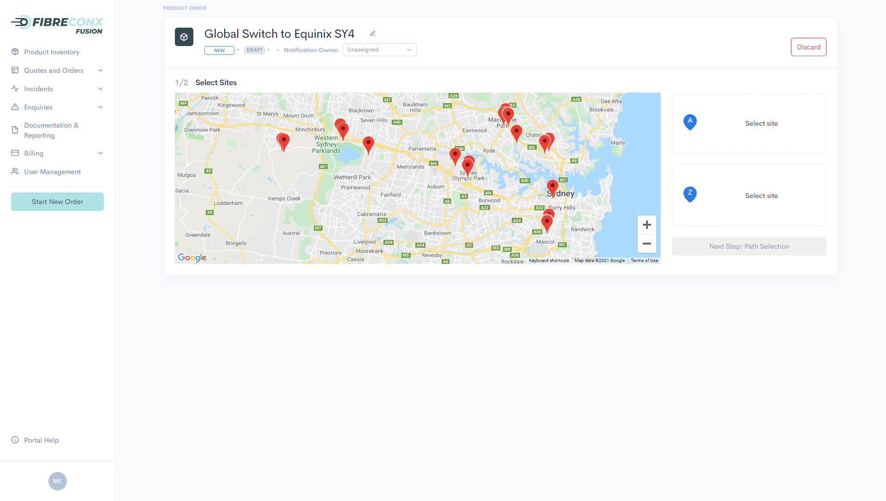
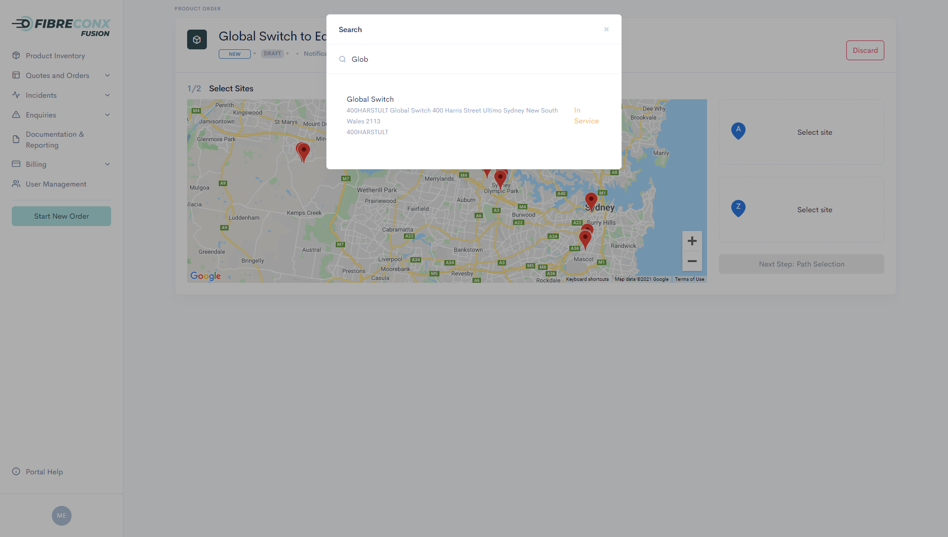
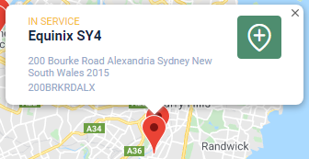
Qualification, Quoting & Ordering
Service Inventory
Raising Service Incidents & Enquiries
Invoicing & Payments
User Administration
1
2
3
4
3
1
Site Selection from List
If you’re not sure on the location of the site you want to qualify, clicking on select site allows you to search based on building name/operator or address.
Site Presentation
All available sites are presented in the map & list based on the product type & region selected on the previous screen.
2
Site Selection from Map
Sites can be selected directly from the map if you know where the site is located. The site name and address is shown to allow you to confirm before selection.
< Previous
Next >
Notes:
Submitting an Order – Screen 1

Slide 3
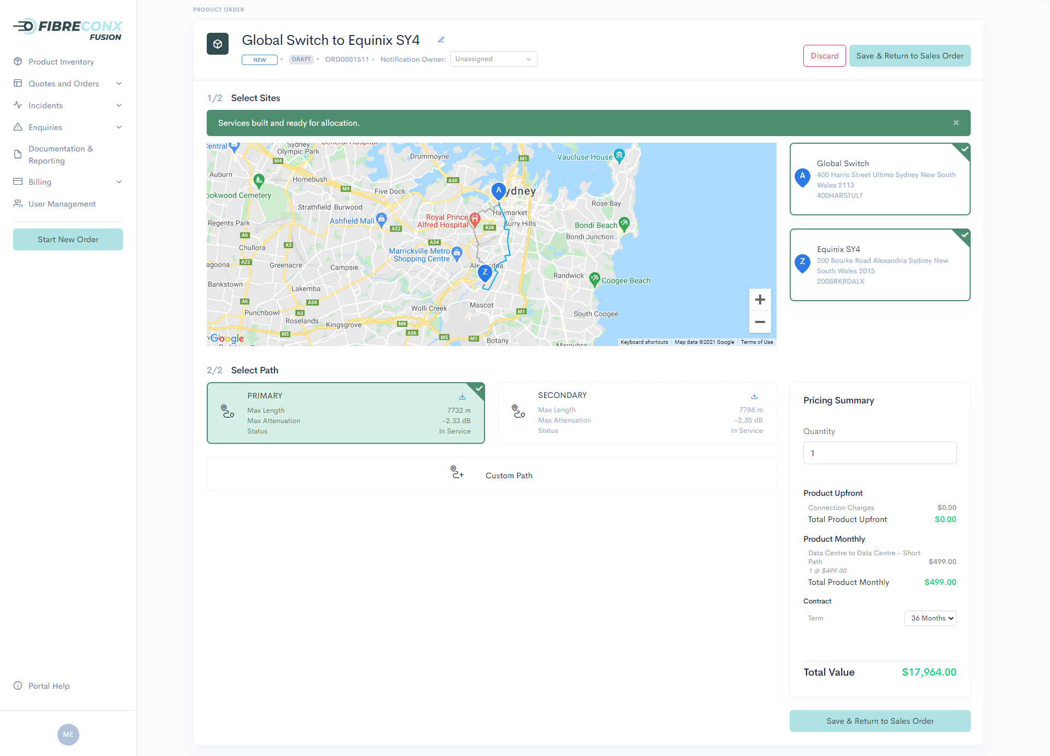
Qualification, Quoting & Ordering
Service Inventory
Raising Service Incidents & Enquiries
Invoicing & Payments
User Administration
1
2
3
4
3
Path Availability
You’re advised during the qualification process of the real-time availability of pre-built fibres
- Green: Lots
- Amber: Limited
- Red: None currently
available but will be
delivered within five
(5) business days
Order > 1 Service
FibreconX supports ordering multiple dark fibre services in a single transaction
2
5
KML Download
Path KML file is available for immediate download to allow you to compare available paths to your existing service paths (if applicable)
1
Path Selection
The most efficient diverse paths are presented, with fibre distances and anticipated attenuation figures
4
Custom Path Selection
If the proposed paths don’t meet your requirements, select ‘Custom Path’ and provide your requirements
Real-time Quoting
Receive an instant quote for services
6
< Previous
Next >
Notes:
Submitting an Order – Screen 1

Slide 4
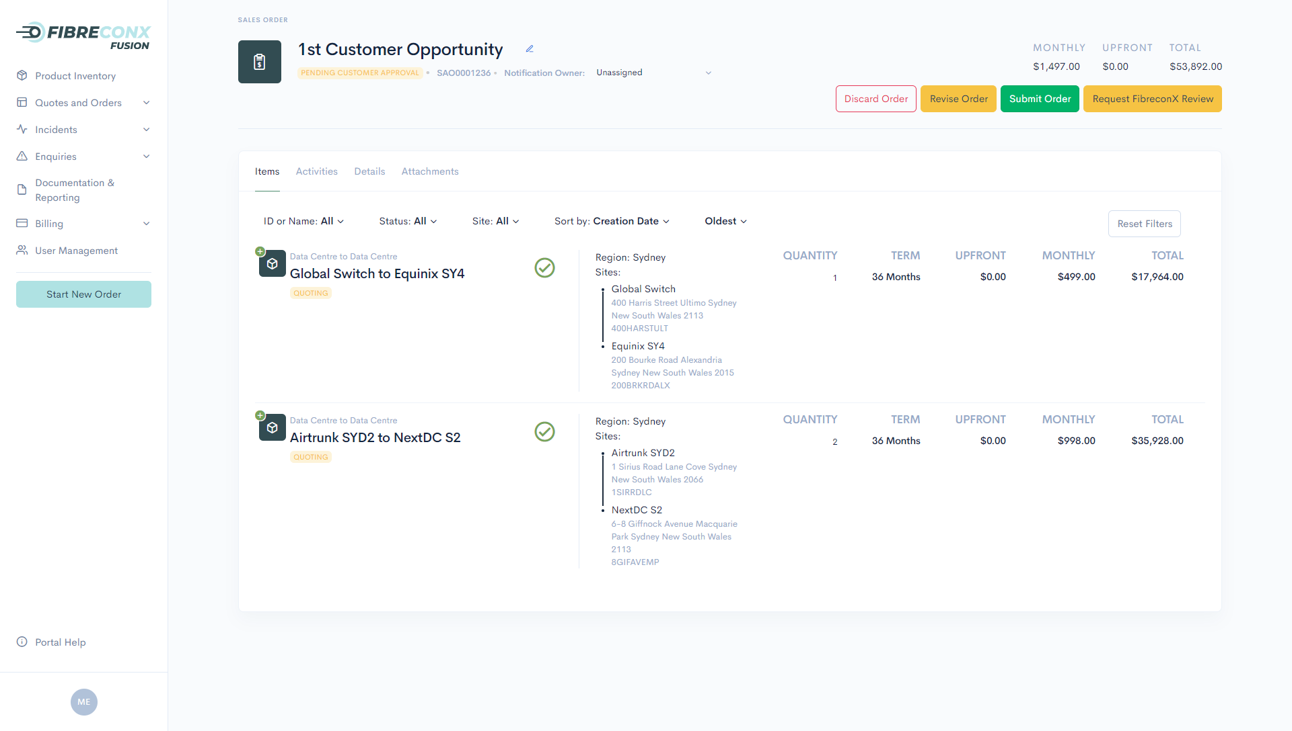
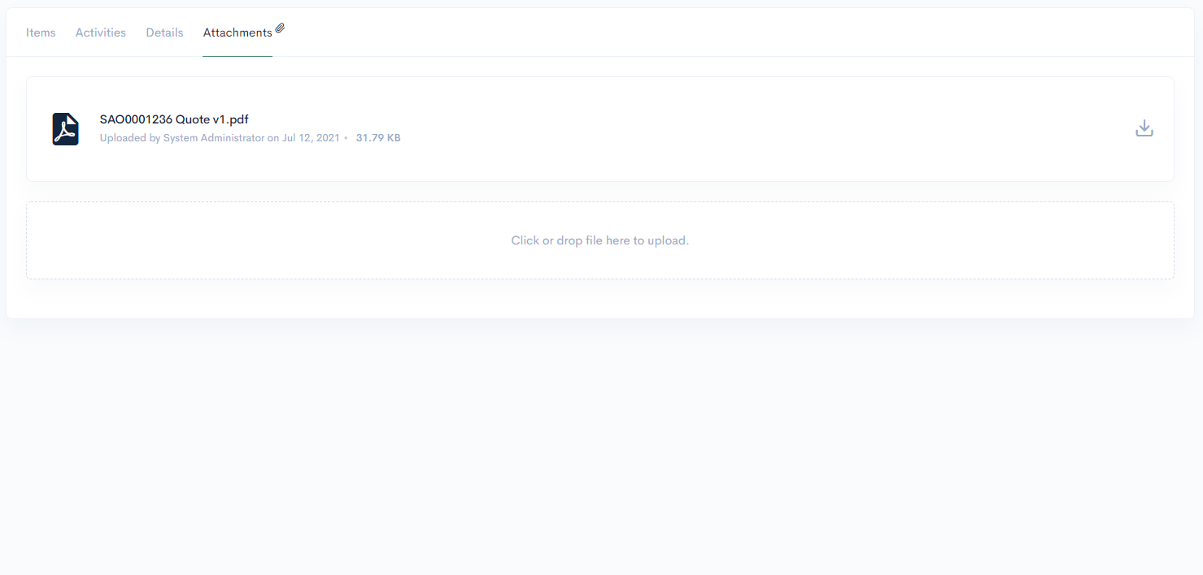
Qualification, Quoting & Ordering
Service Inventory
Raising Service Incidents & Enquiries
Invoicing & Payments
User Administration
1
2
3
4
Dynamic Quote Rendering
Need to provide your finance team with a PDF quote in order to get internal approval? Check out the attachments section
2
Total Sales Order Charges
See the total costs (once-off, recurring & total contract value) in one location
4
3
Quote Submission
Unsure if your Sales Order is correct, or you’ve requested a custom path? Push the order for FibreconX to review and we will receive a notification.
Happy with your order and want to see live provisioning of dark fibre services, hit ‘Submit Order’
1
Product Order Listing
Add multiple paths to a single Sales Order (quote) using naming which is meaningful to you and your customers
< Previous

Slide 5
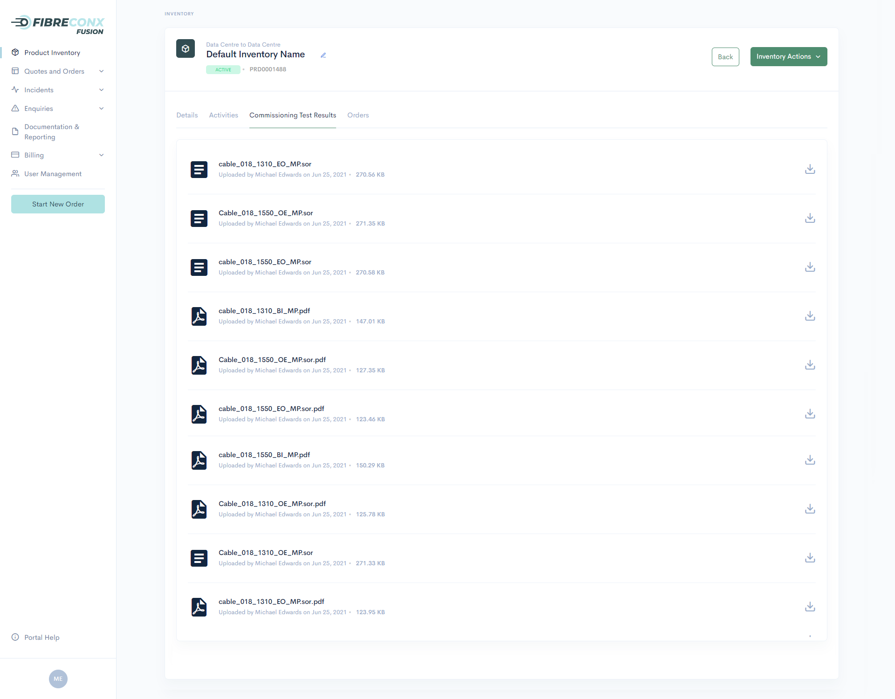
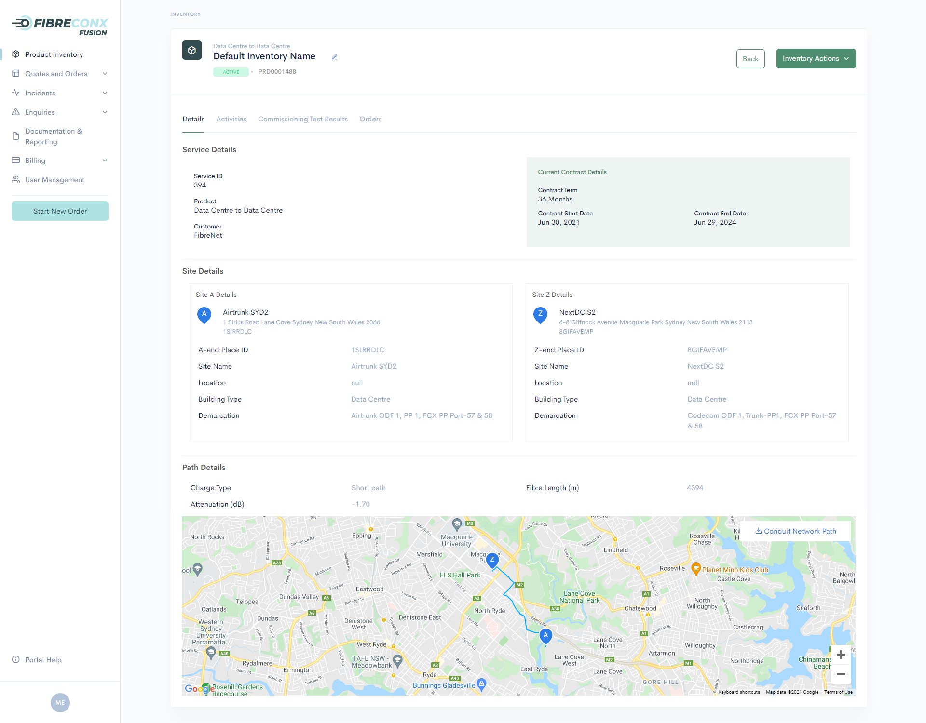
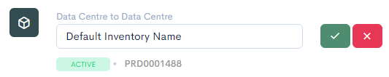
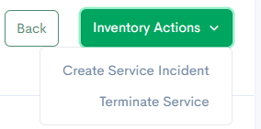
Qualification, Quoting & Ordering
Service Inventory
Raising Service Incidents & Enquiries
Invoicing & Payments
User Administration
InventoryActions
Raise a service incident, extend your contract, or terminate your service, all in the context of the service you are viewing
1
7
Commissioning Test Results
See the commissioning test results for your service immediately. This provides both you and FibreconX with a baseline to allow troubleshooting later.
Control Service Reference
Name your service according to your naming convention. While FibreconX has our own Service ID, you can associate your own naming to simplify your operations.
5
6
Contract Details
See when your current contract starts & ends, noting FibreconX delays billing for the service for three business days while your cross connects are delivered. Note: Historical contracts are visible in the ‘Activities’ tab
2
Product Order Listing
See all the important details relating to your service
- Service ID
- Two sites it is connecting
- Exact fibre distance
- Actual attenuation (@1550nm)
3
Demarcation Details
Immediately receive the demarcation details for services delivered to data centre, allowing you to order your cross connects in a language the facility operator understands
4
Path Details
See the path your service takes along the FibreconX conduit network, and download the KML (guaranteed same path that you saw during the ordering process)

Slide 6
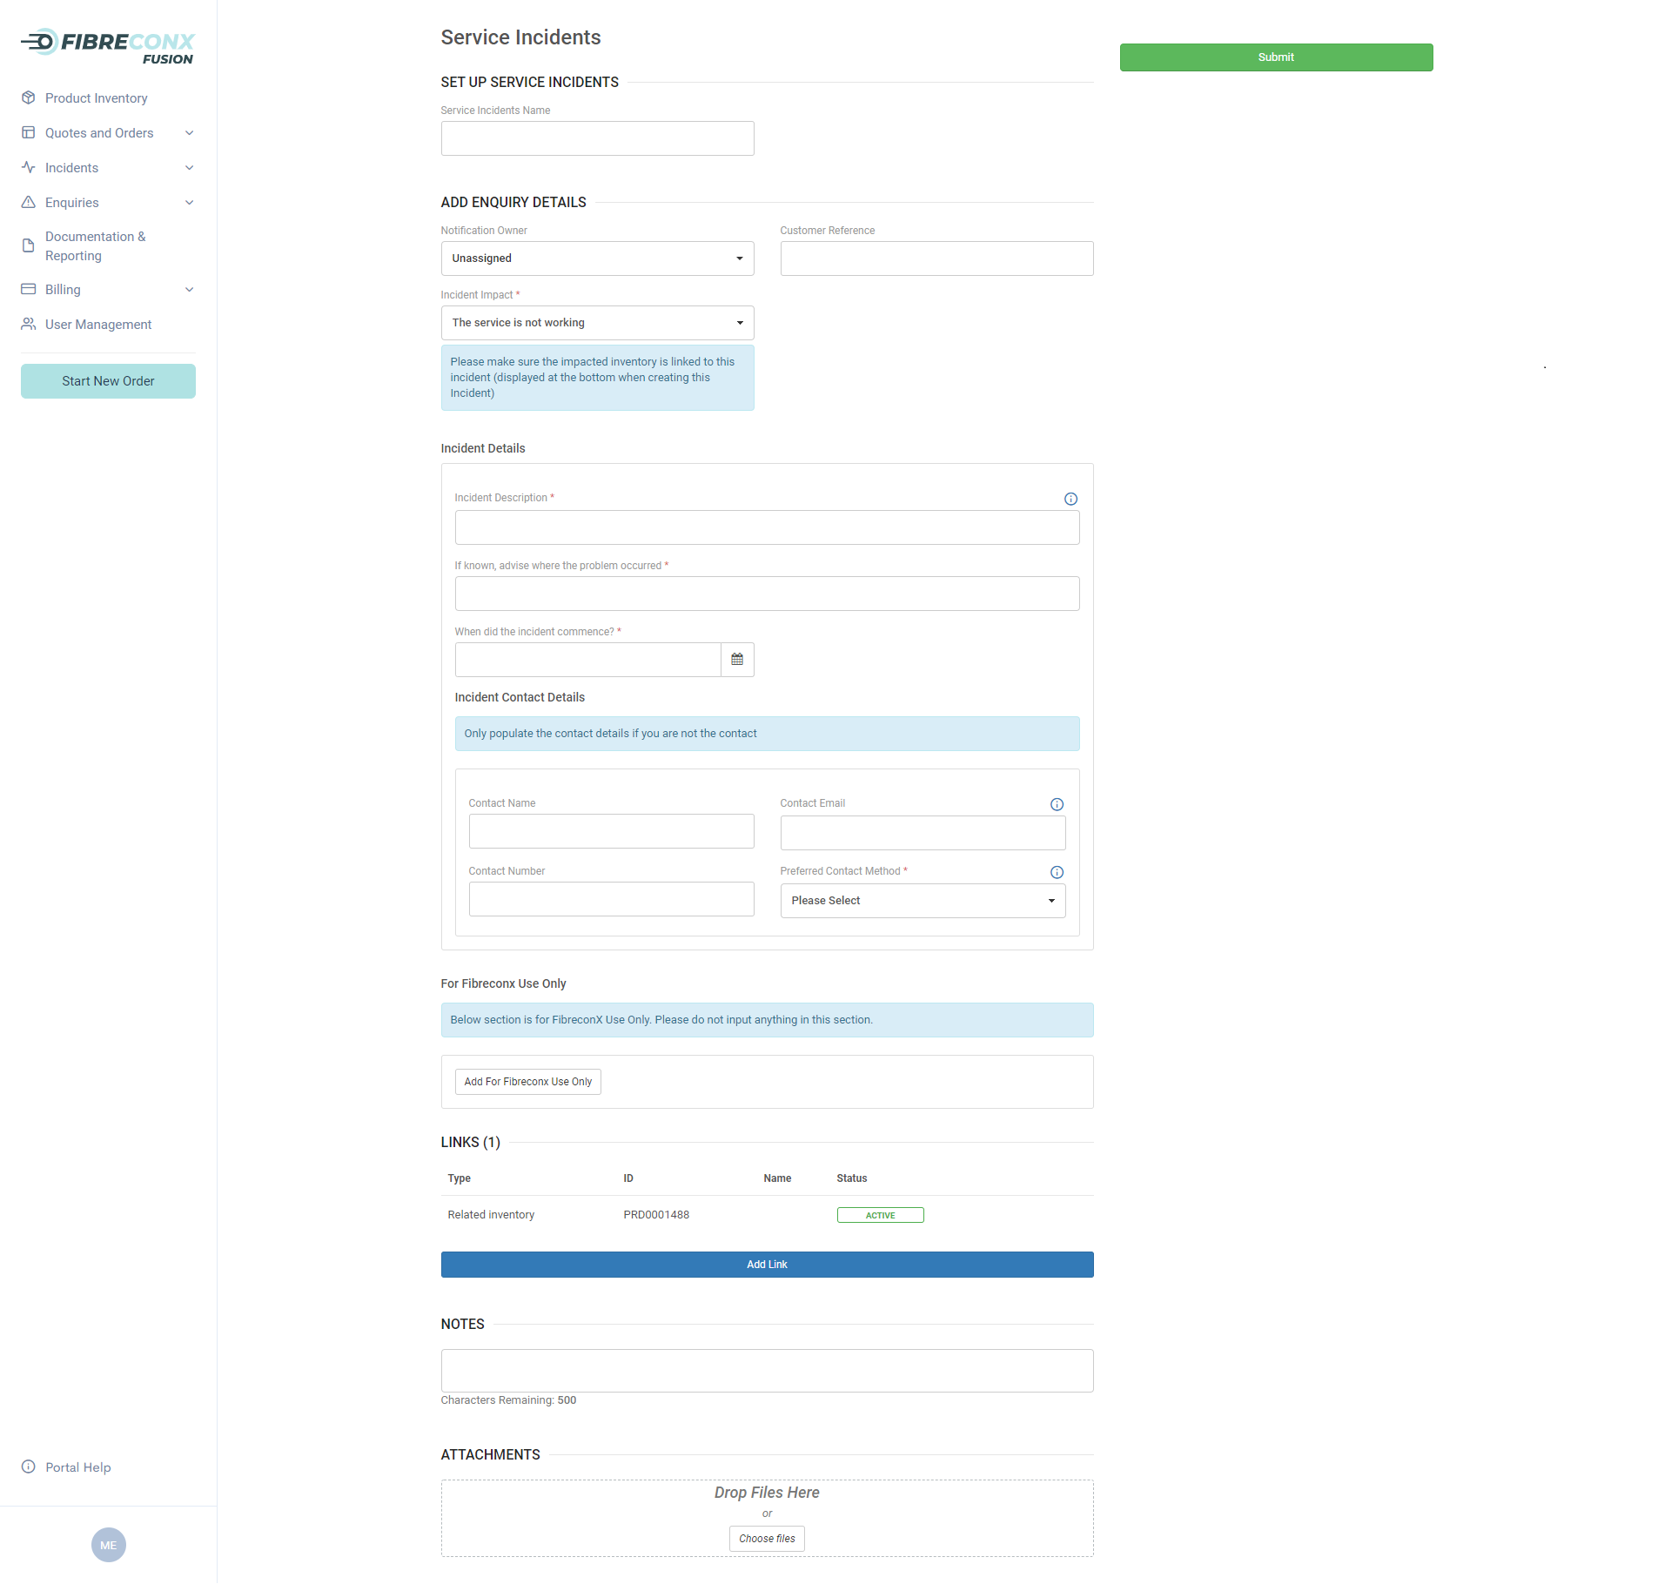
Qualification, Quoting & Ordering
Service Inventory
Raising Service Incidents & Enquiries
Invoicing & Payments
User Administration
Service Incident High Level Details
Advise the person or team who should receive notifications relating to the service incident, your internal ticket reference, and the impact (i.e. service not working vs degraded)
1
Incident Details
Describe in detail what has occurred, what investigation you have done to isolate the location of the issue, and the date/time you first noticed the issue
2
Incident Contact
Allows you to advise who to contact to find out more detail (if required), and to allow FibreconX or our contractors to work with this person to locate and restore the issue
3
Associated Services
Make sure you add all services which are impacted by the incident as this will potentially assist in identifying the location of the issue
2
Attachments
Enables you to add documents to provide as much detail as possible to assist us to resolve the issue
1

Slide 7
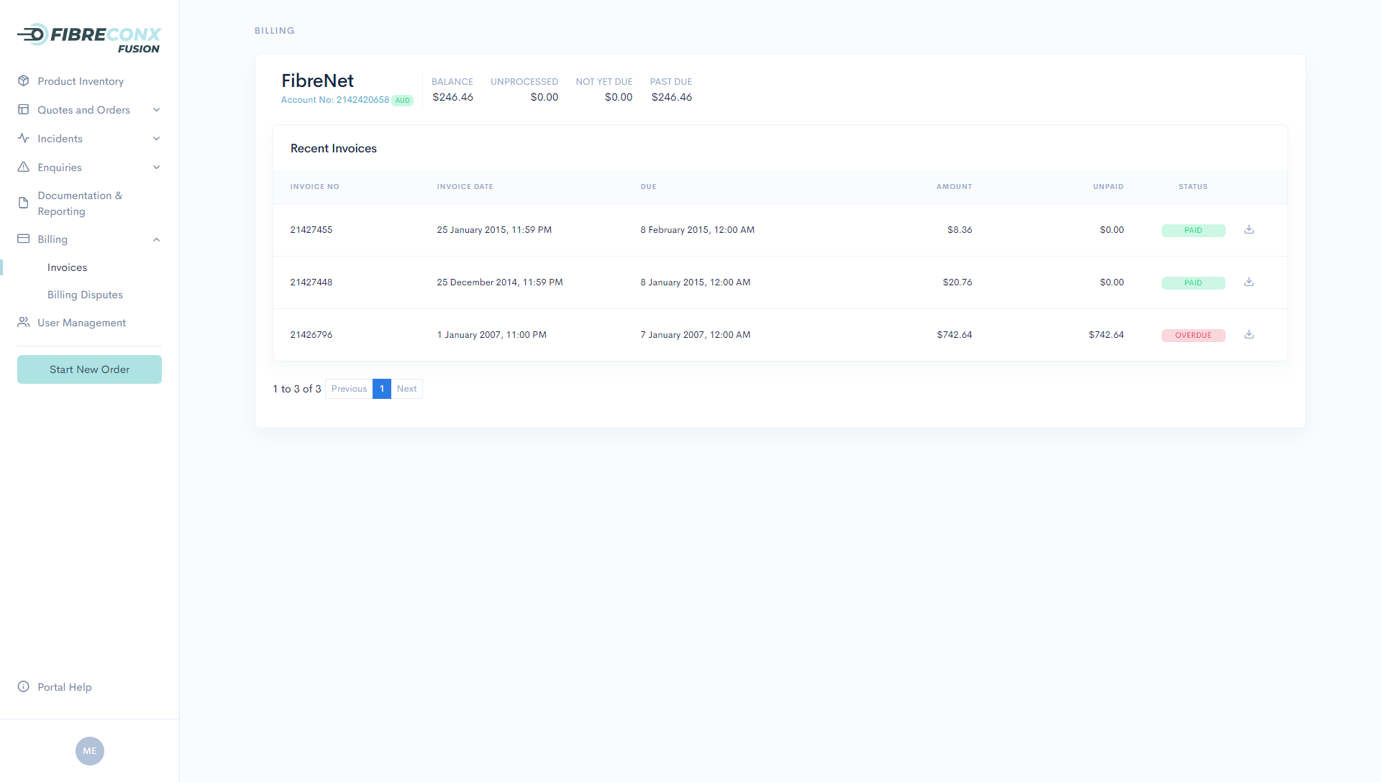
Qualification, Quoting & Ordering
Service Inventory
Raising Service Incidents & Enquiries
Invoicing & Payments
User Administration
Invoice Download
Unable to find the email containing your recent FibreconX invoice? Download your historical invoices from the FibreconX Fusion Portal
2
Account Balance
View your account balance in a single location
4
1
Invoice Listing
See a list of all your existing FibreconX invoices in a single location
Note: Access to this page can be restricted to individual user accounts within your organisation
3
Invoice Payment Status
See the current status of each invoice

Slide 8
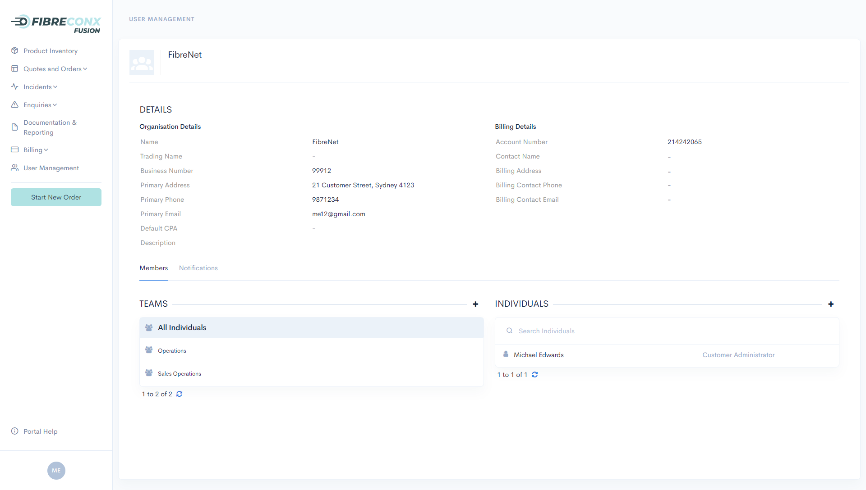
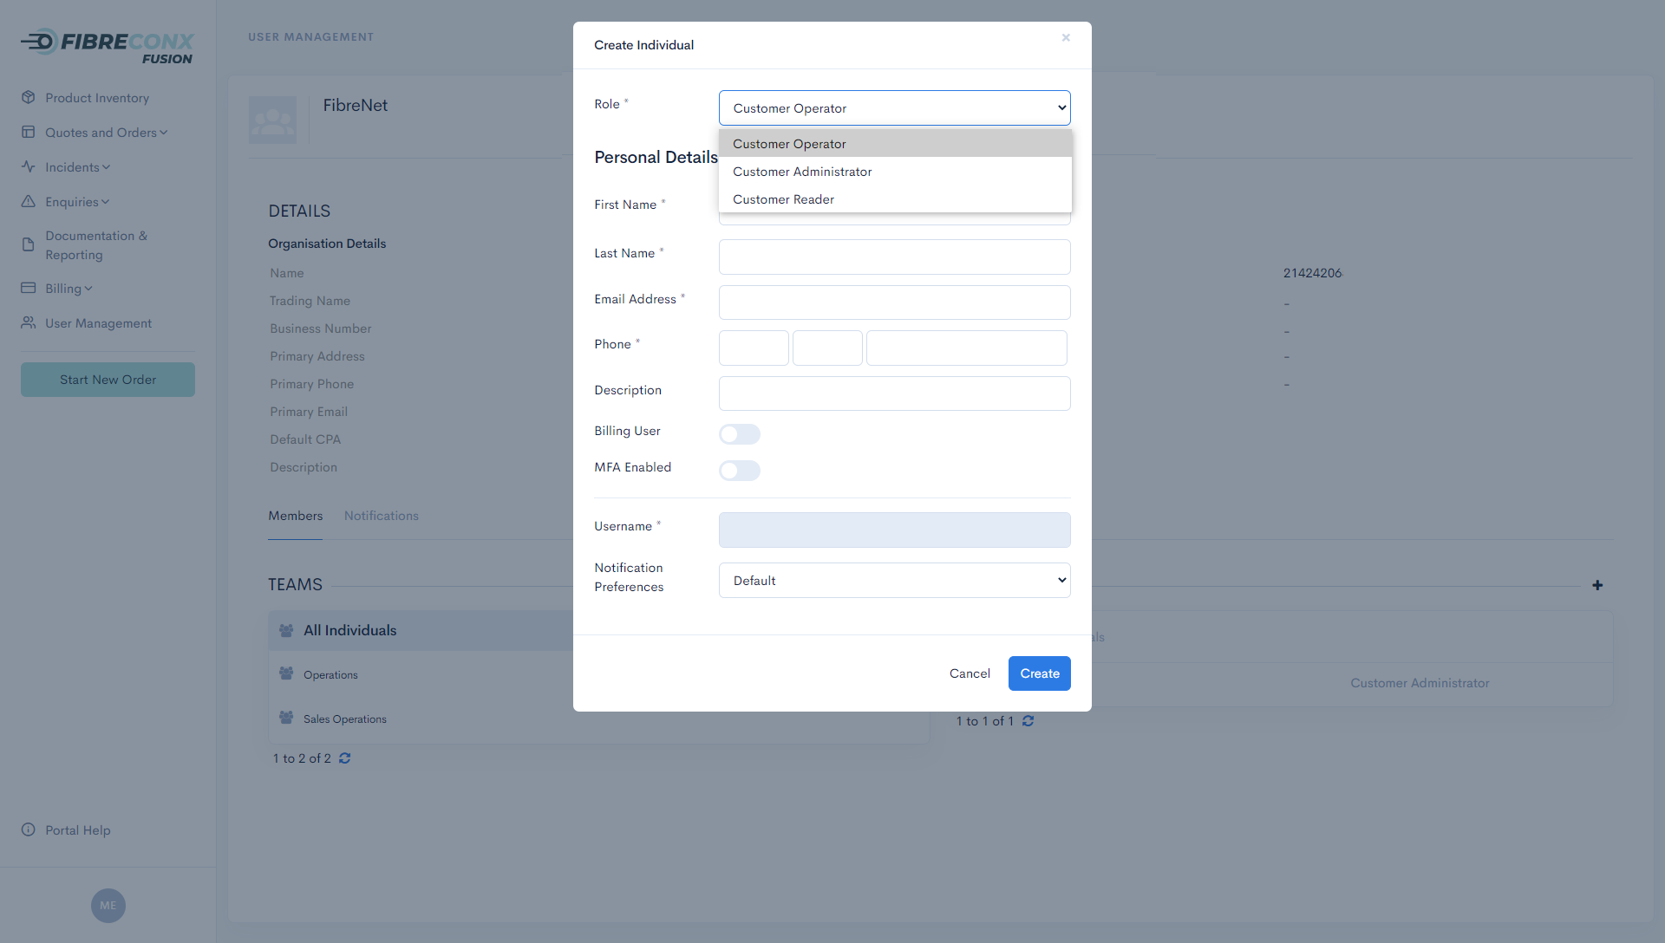
Qualification, Quoting & Ordering
Service Inventory
Raising Service Incidents & Enquiries
Invoicing & Payments
User Administration
1
Organisation Details
See all the important details FibreconX records about your organisation, noting the ‘Primary Email’ is the email address where all Network Event notifications are sent.
Add User Accounts
Add user accounts for individuals you want to be able to interact with FibreconX, noting Administrators:
- Add, edit & delete user accounts within your organisation
- Control Multi-Factor Authentication (MFA) settings on a per user basis
- Manage which users can see the Invoice & Payments menu
4
3
Teams
Manage your interactions with FibreconX how you want to, whether directly with individuals, or through teams, generally where teams are identified by a distribution list/group email address
2
Individual User Accounts
See all your users in a single location

